Slide 1



"SMART GYESER"
K S SCHOOL OF ENGINEERING & MANAGEMENT,
BENGALURU-560109
DEPARTMENT OF ELECTRONICS AND COMMUNICATION
ENGINEERING
SEMINAR (15EC84 )
Internship carried out at
Presented By
UDAY L
1KG16EC110
ON 12-5-2020
Internal Internship Guide
Mrs.KRIPA KB
Asst. Prof, ECE, KSSEM
External Internship Guide

Slide 2
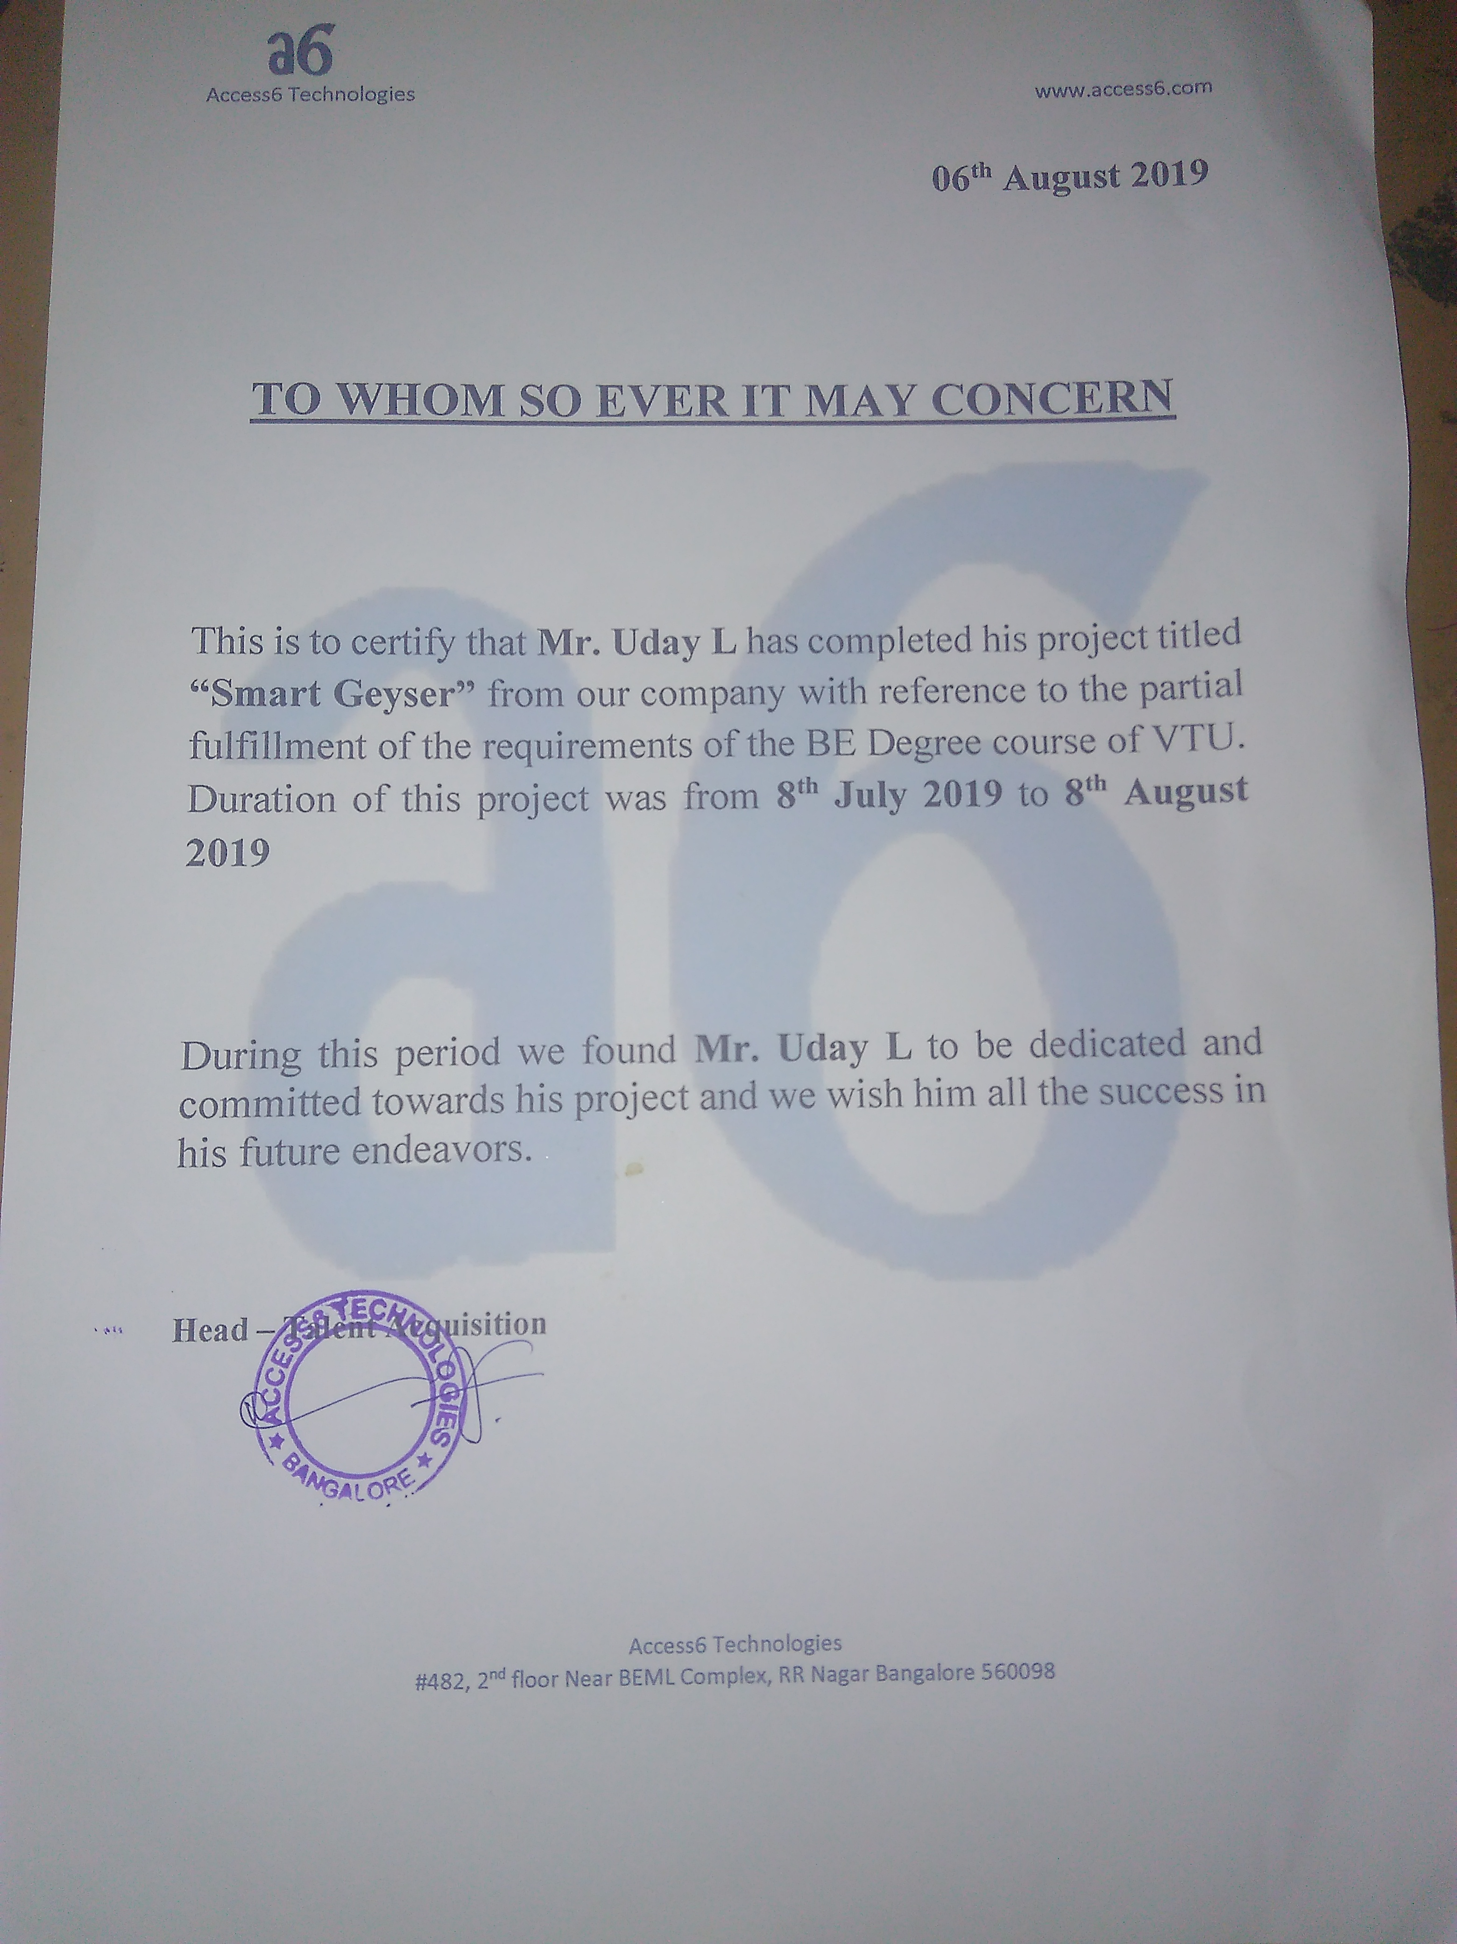
INTERNSHIP CERTIFICATE

Slide 3
CONTENTS
COMPANY PROFILE
ABSTRACT
INTRODUCTION
TYPES Of GEYSER
ADVANTAGES
HARDWARE COMPONENTS
BLOCK DAIGRAM
FLOW CHART
IMPLEMENTAION
TECHNOLOGY

Slide 4
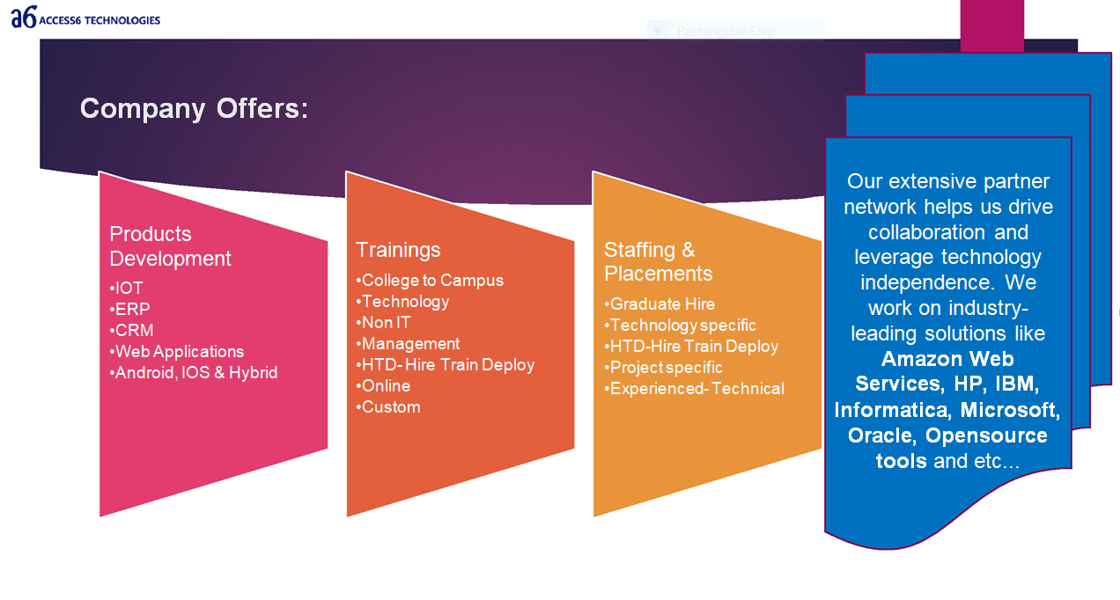
COMPANY PROFILE
Access6 is a Global Information & Technology Company. Which has philosophy of ―Connecting Dots…‖ which aims to do business & provide complete satisfaction to Customers by practicing understanding the business needs and providing subsequent solution to the Clients, we aim to evolve as a complete & One Stop Information & Technology Company‘.
MAJOR APPLICATION
Fleet management systems
Hospital management systems
Digital marketing and SEO/SCM/SEM
Mobile Application
Web Based e-Printer
Smart Bin
Smart Energy Management System

Slide 5
ABSTRACT
Today we are in world which is growing very fast in terms of technology ,so each and very device and equipment's needs to be very efficient and must be less time consuming .
The use of hot water used for bathing is one type of utilization of technology that has been developed.
Water geyser is used for thermodynamically heating water above its normal temperature. Its usage incorporates in bathing, washing, cooking & many where.
So our project SMART GEYSER deals with the idea of water heating with less time and improved safety by using induction technology. We analyzed how human body interacts to different temperature levels of water & the water heating system would serve according to the need of a person.
The system is smart since user can give inputs, he requires i.e. the amount of water in liters and the required level of temperature through a remote. Then the system processes the given inputs and outputs the result as desired by user.

Slide 6
INTRODUCTION TO SMART GEYSER
Today’s water heaters are easy, convenient and safe to use. Once installed, they need to be switched on and within no time hot water would flow from the faucet.
Geyser consumes large amount time to transfer the heat, to reduce the time consumption we have come across a Smart Geyser which consumes very less amount of time to transfer the heat to required temperature .
Once hot water is released from the water heater, then more cold water comes in and is constantly being heated. With this, a large amount of energy will be wasted when your taps are turned on.
New water heaters are being designed and upgraded to help reduce the level of energy consumption and reduce the cost of heating water when hot water isn‘t currently in use.

Slide 7
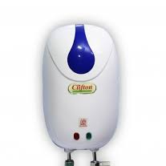
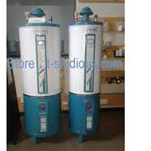
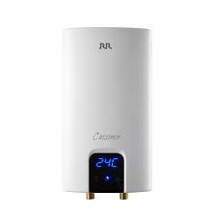
TYPES OF GEYSER
TANGLESS GEYSER HYBRID GEYSER STORAGE GEYSER

Slide 8
ADVANTAGES
Have Control Over Your Water Heating System
Smart Technology Brings Safety
Saves energy

Slide 9
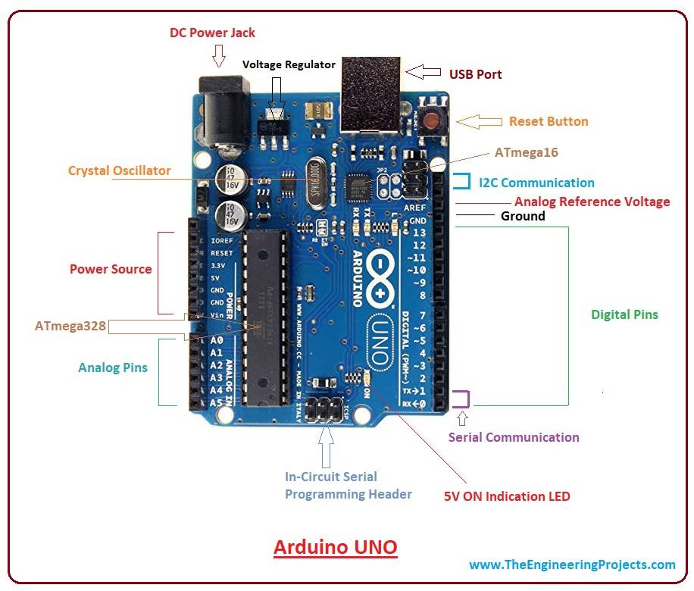
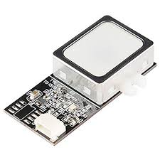
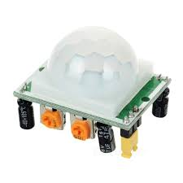
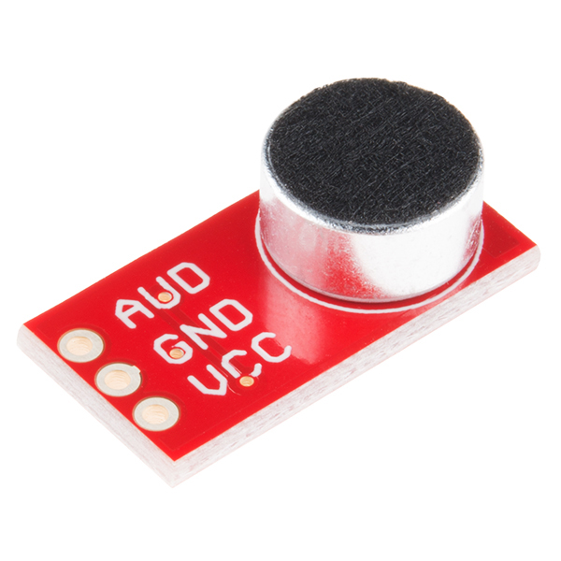
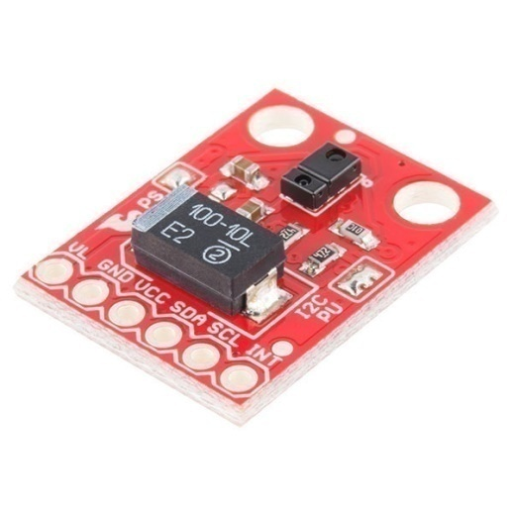
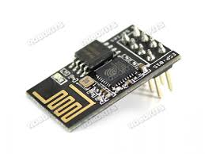
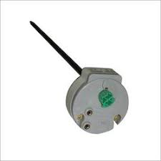
HARDWARE COMPONENTS
ARDIUNO UNO
PIR SENSOR
VOICE RECOGNITION MODULE
WIFI MODULE
THERMOSTATS
BUZZER
IR SENSOR
FINGERPRINT SENSOR

Slide 10
ARCHITECTURE
Hot water cold water
Thermostat
Water of
required
temperature
Led display
Fingerprint Sensor
And
Gesture Recognition
The required temperature of each person is stored and accessed when required
Voice Recognition
Using mobile
Output

Slide 11
FLOW CHART
START
FINGERPRINT SENSOR
PIR SENSOR
SENSE MOTION
LIGHTS OFF
SWITCH ON LIGHTS
CHANGE THE TEMPERATURE TO REQUIRED VALUE
USING VOICE AUTOMATION, TELL THE USER THE DEFAULT TEMPERATURE
OK?
TAP
STOP

Slide 12
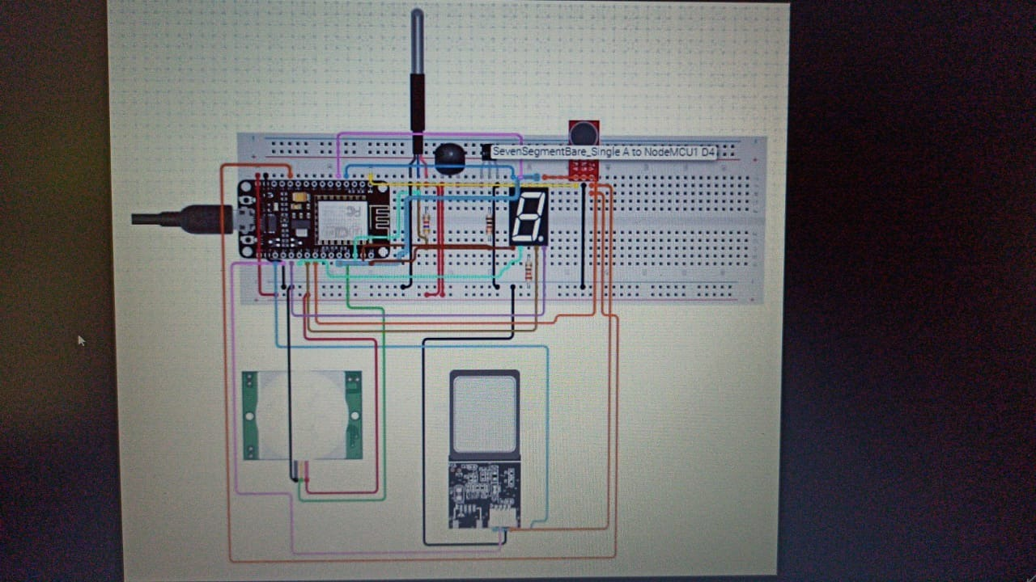
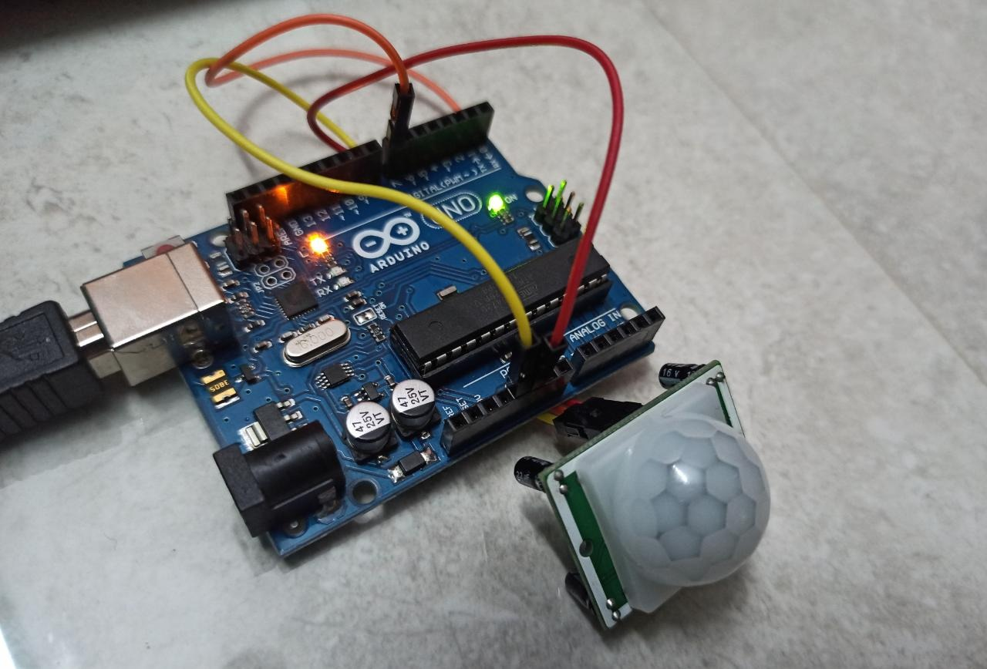
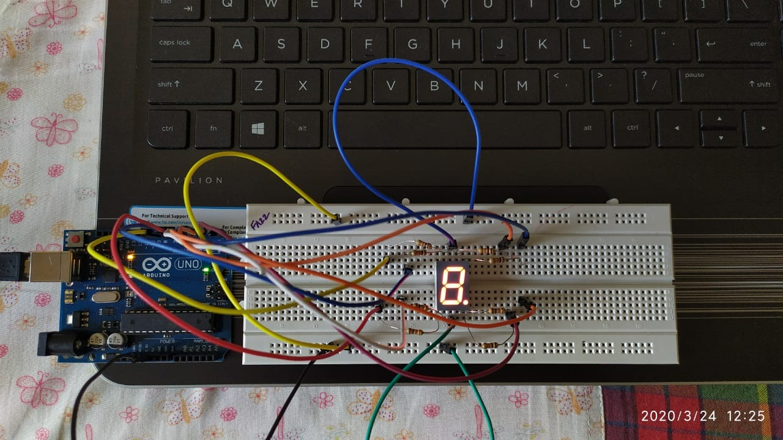
IMPLEMENTATION

Slide 13
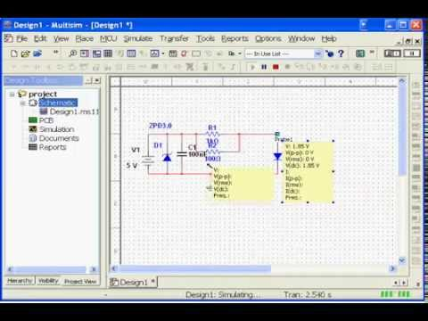
TECHNOLOGY MULTISIM SOFTWARE
Multisim software integrates industry-standard SPICE simulation with an interactive schematic environment to instantly visualize and analyze electronic circuit behavior. NI Multisim is a powerful schematic capture and simulation environment that engineers, students, and professors can use to simulate electronic circuits and prototype Printed Circuit Boards (PCBs). This article shows you how to capture, simulate, and lay out your first design in Multisim.

Slide 14
MULTISIM TOOLBARS
The toolbars listed below are available in Multisim:
• Standard Toolbar
• Main Toolbar
• Simulation Toolbar
• View Toolbar
• Components Toolbar
• Virtual Toolbar
• Graphic Annotation Toolbar
• Instruments Toolbar

Slide 15
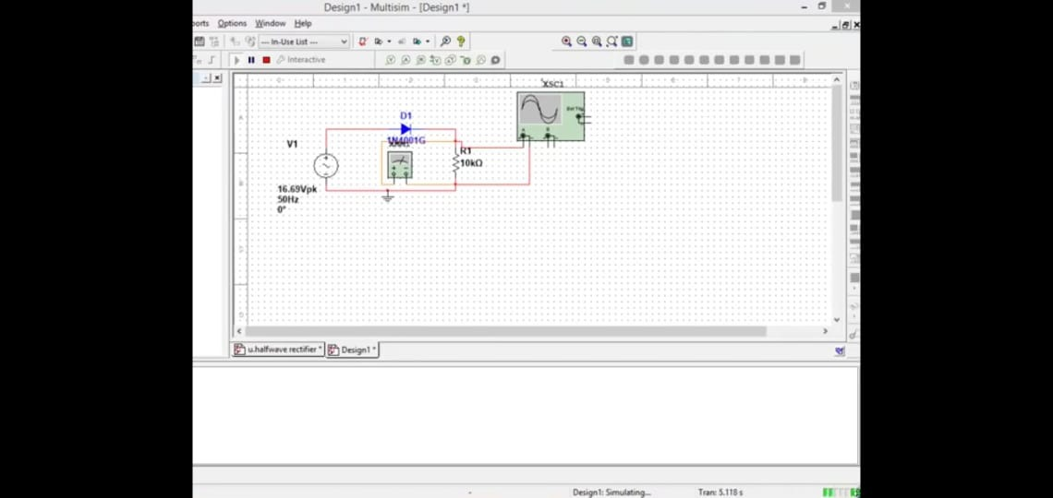
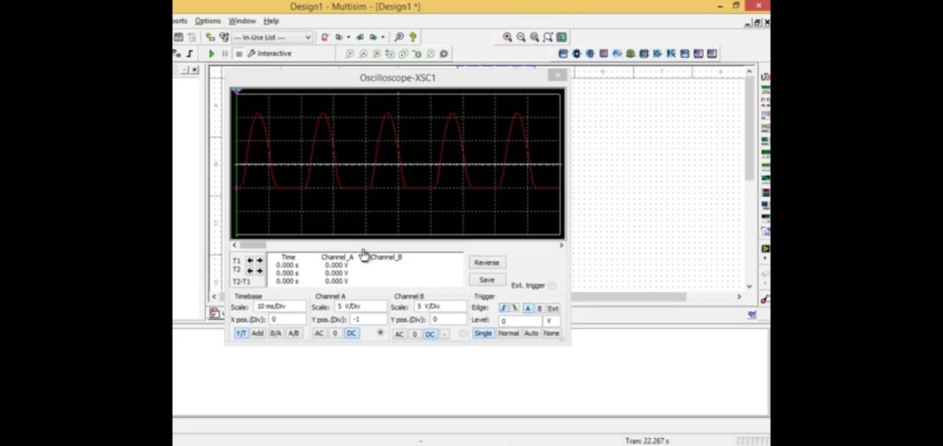
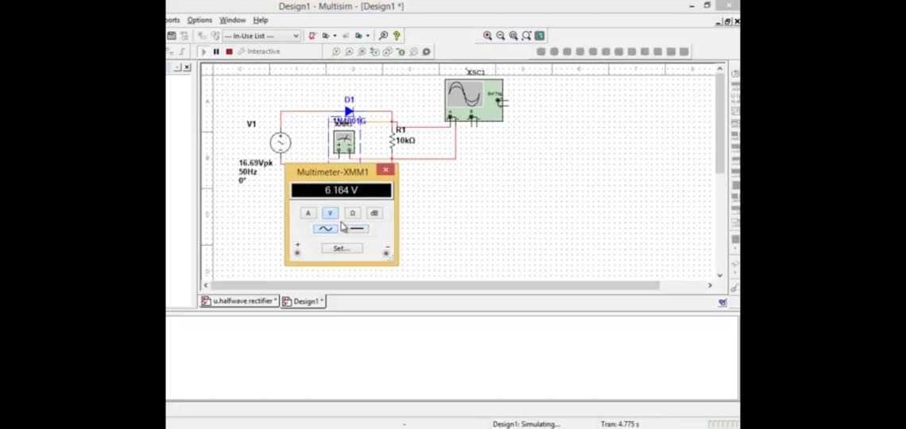
HALF WAV ERECTIFIER DESIGN USING MULTISIM

Slide 16
CONCLUSION
To implement a new real time project called ‘smart geyser’, we have designed a flow chart and architecture of a system. which tells us about working and overall outcome.
This incorporates different types of sensors, and wireless technologies like Wi-Fi, Bluetooth network with custom application software, fixtures and enclosures to construct the complete test system.
Multisim helps us easily visualize and understand the behavior of electronics with 30+ intuitive simulated instruments.

Slide 17
THANK YOU

